Slide 1
Analyzing Trends and Frequency of Bird Strikes in Aviation
Student Name : Rohan Ashok Gonabal
Course 7 : Design Interactive Dashboards Using Tableau
Batch Code : DA464S46
Project Guide : Komilla Bhatia

Slide 2
Problem Statement
Bird strikes pose a significant threat to aviation safety, leading to costly damage, flight delays, and, in rare cases, loss of life. These incidents are most common near airports, especially in areas close to wetlands, landfills, and migratory bird paths. Despite advancements in technology and airport wildlife management, the frequency of bird strikes remains a challenge. There is a need for data-driven strategies to identify high-risk zones, assess environmental factors, and implement effective mitigation measures to reduce bird strike incidents and enhance flight safety.

Slide 3
Objectives
Analyze bird strike data based on location, altitude, time, and season to identify key patterns.
Identify high-risk airports and zones using geospatial and historical strike data.
Evaluate current bird strike mitigation strategies to assess their effectiveness.
Investigate environmental factors that increase bird activity near airports.
Develop predictive models to forecast bird strike risks using statistical or AI-based techniques.
Assess the impact of bird strikes on flight operations, safety, and economic losses.
Propose improved training and communication strategies for pilots and ground staff.
Recommend policy and technology-driven solutions for long-term wildlife hazard management.

Slide 4
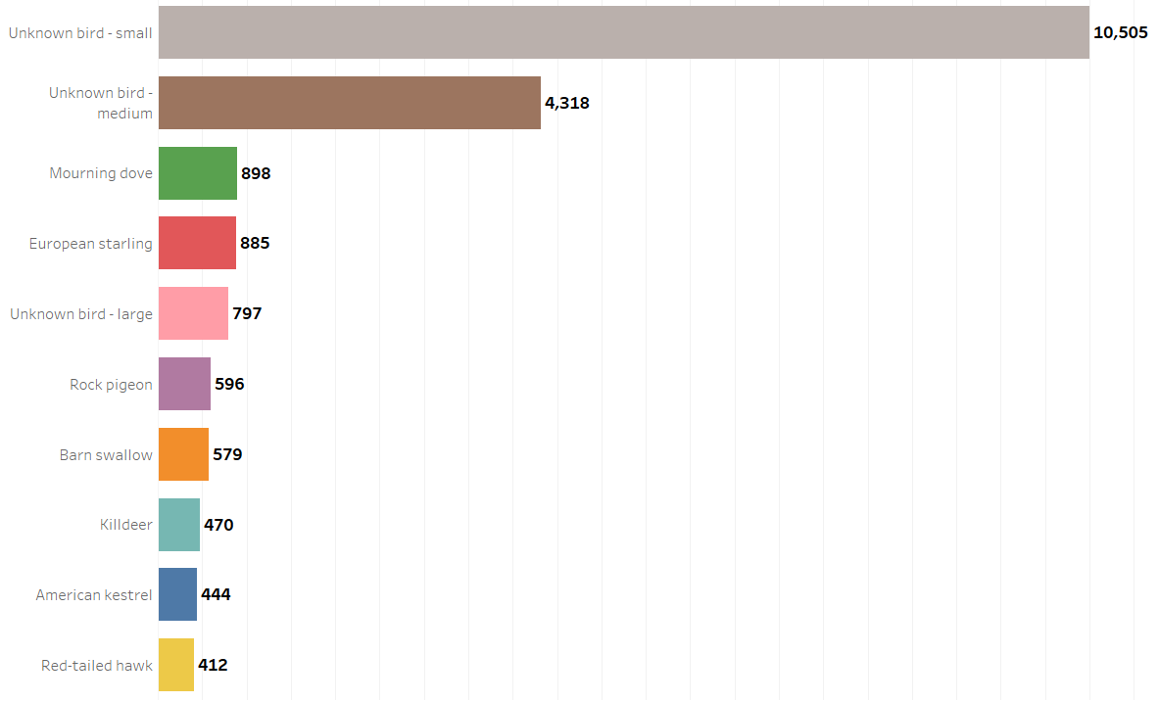
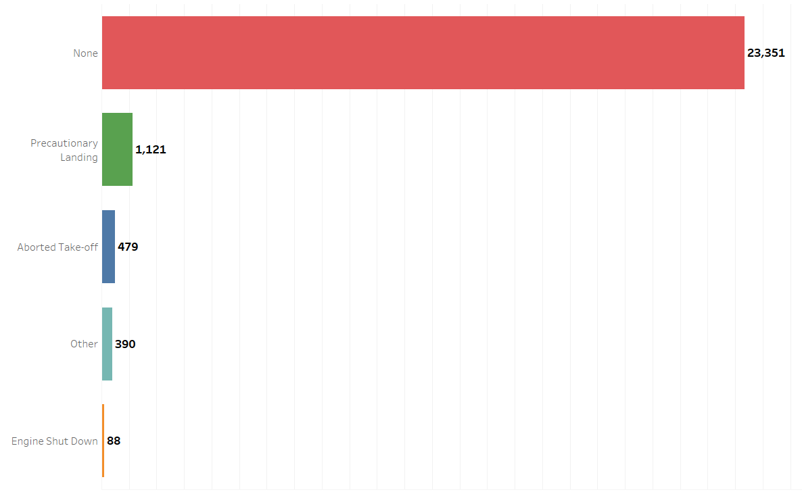
Safety Improvement Analysis
1. Most Common Wildlife Species
2. Impact on Flight Safety
Interpretation:
Unknown Bird Small has the more striking rate.
Interpretation:
Mostly the flights are not striked by any birds.

Slide 5
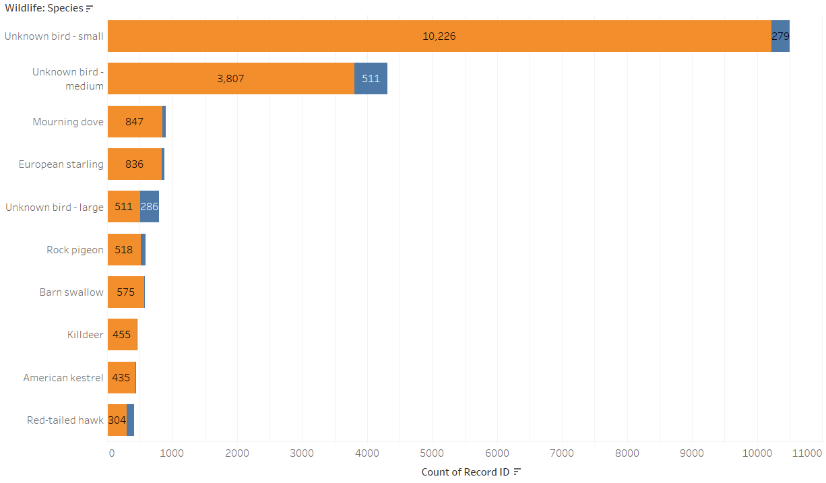
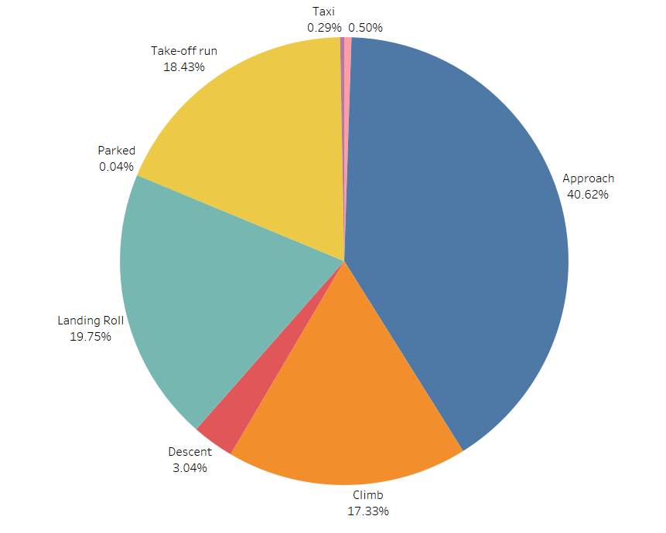
Safety Improvement Analysis
3. Indicated Damage by Species
4. Phase of Flight Analysis
Interpretation:
Unknown Bird Small has more Damage
Interpretation:
During approach phase mostly strikes has happened.

Slide 6
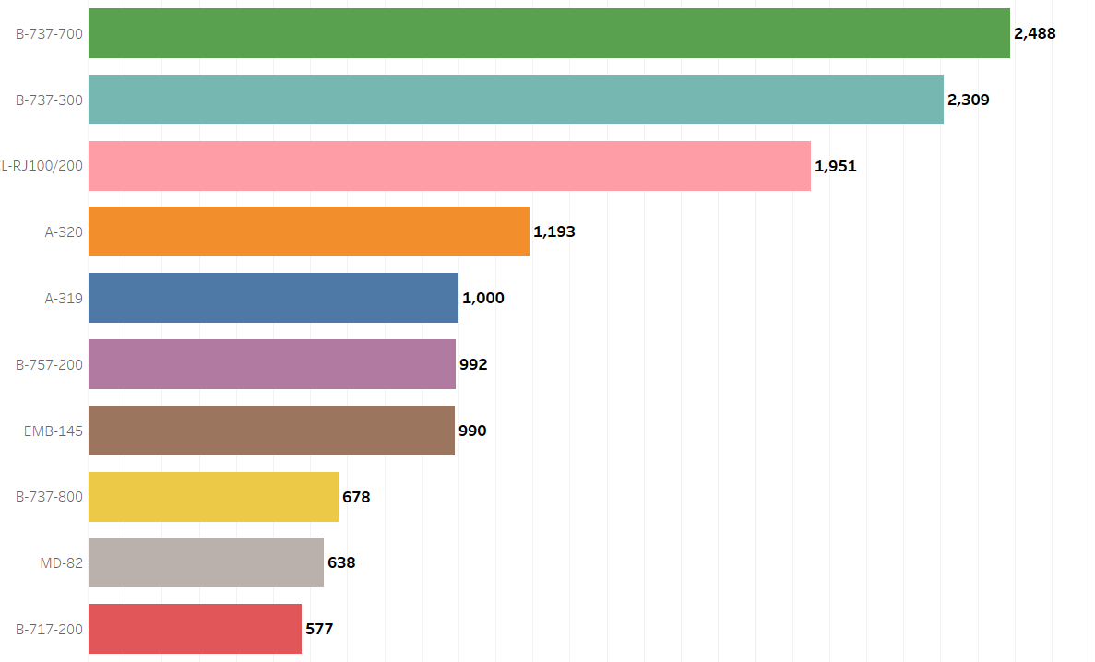
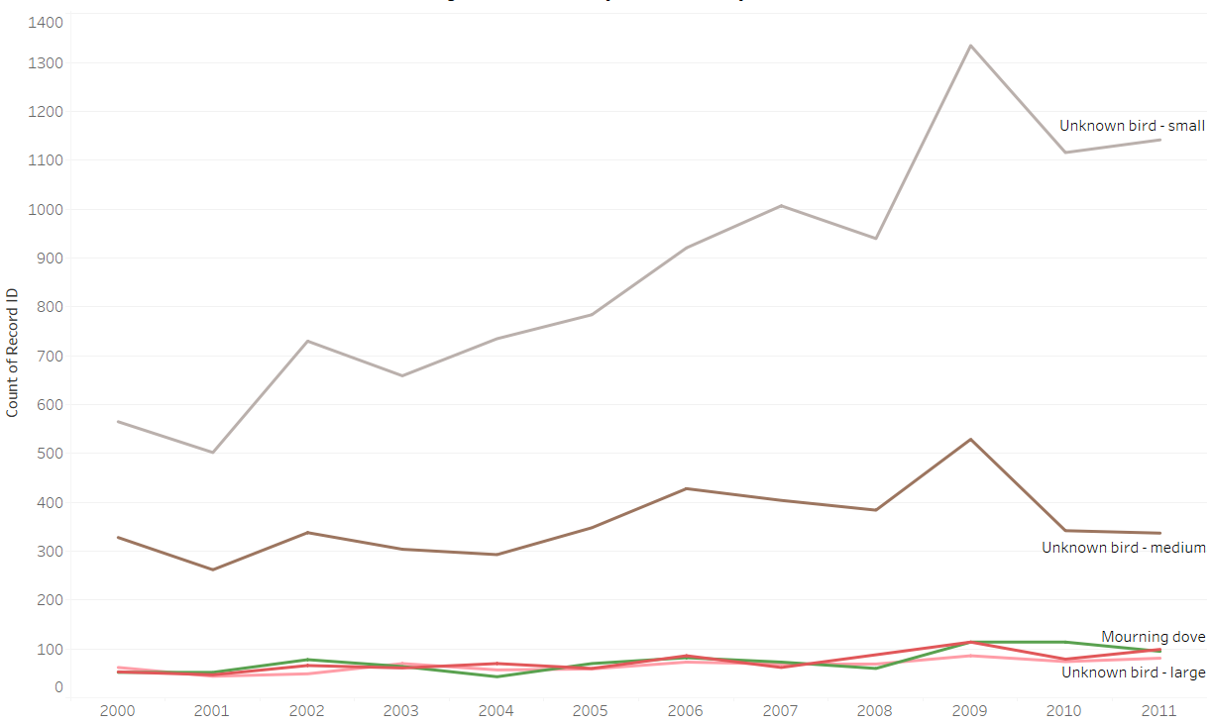
Safety Improvement Analysis
5. Aircraft Make/Model
6. Yearly Trend of Top Wildlife Species
Interpretation:
B-737-700 model most frequently attacked by birds.
Interpretation:
Unknown-small-bird has the most striking rate during 2009.

Slide 7
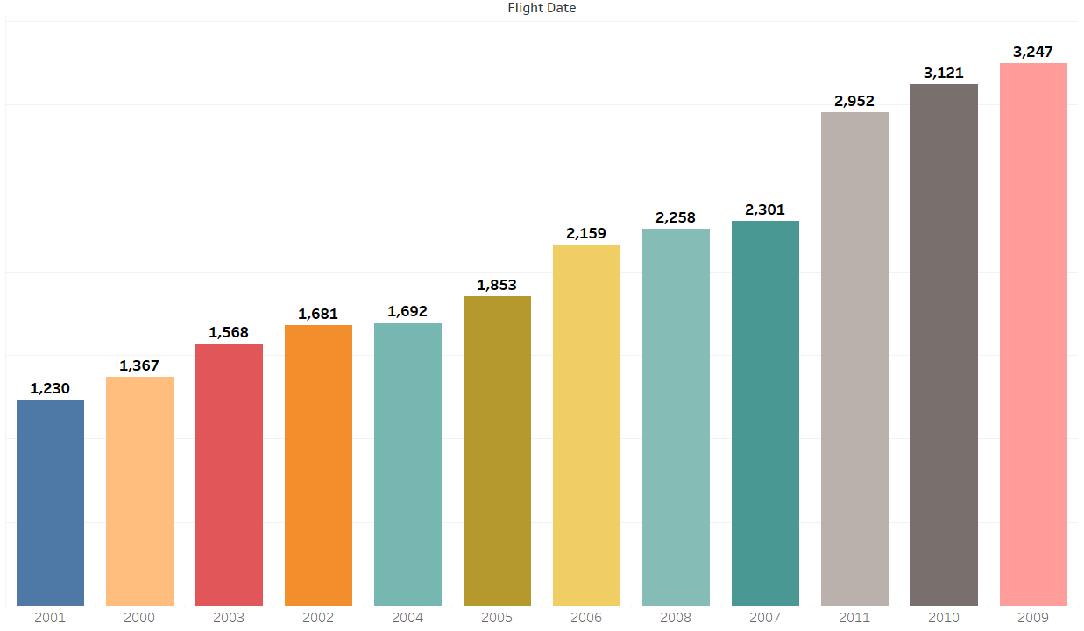
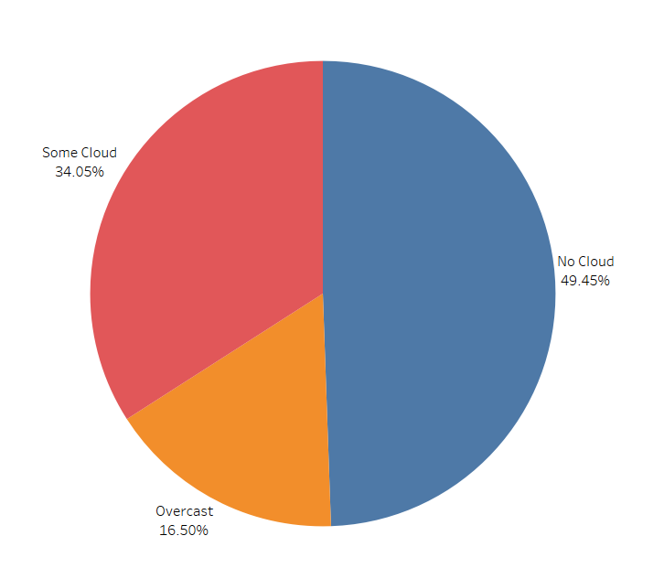
Regulatory Compliance Analysis
1. The busiest year of for airport strikes
2. Sky conditions during hits
Interpretation:
In 2009 year most bird strikes has happened.
Interpretation:
No Cloud has 49.45% Sky conditions during hits

Slide 8
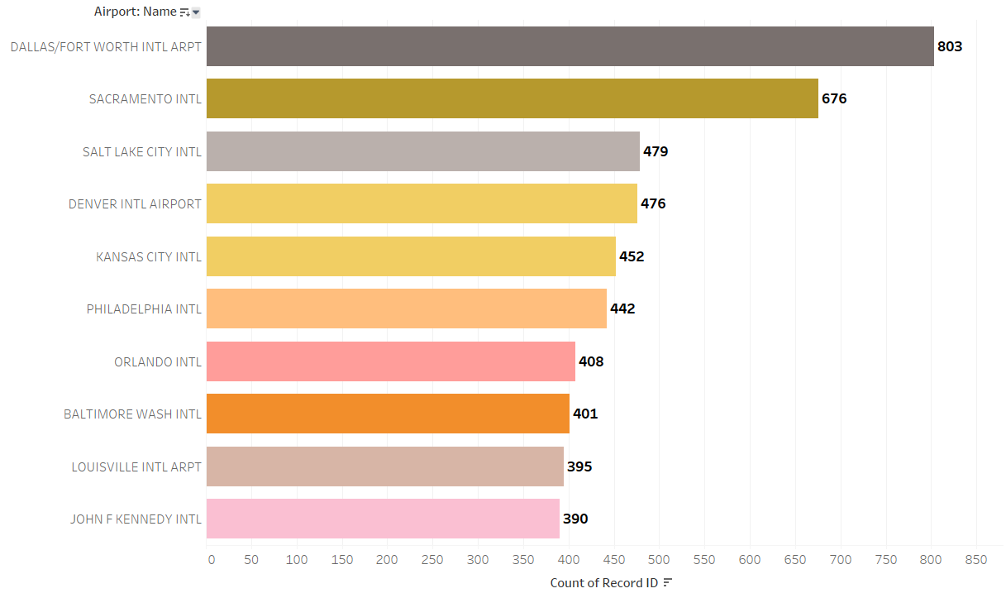
Regulatory Compliance Analysis
3. The airport’s highest number of Birdstrikes
Interpretation:
Dallas/Fort Worth International Airport has the highest number of bird strikes.

Slide 9
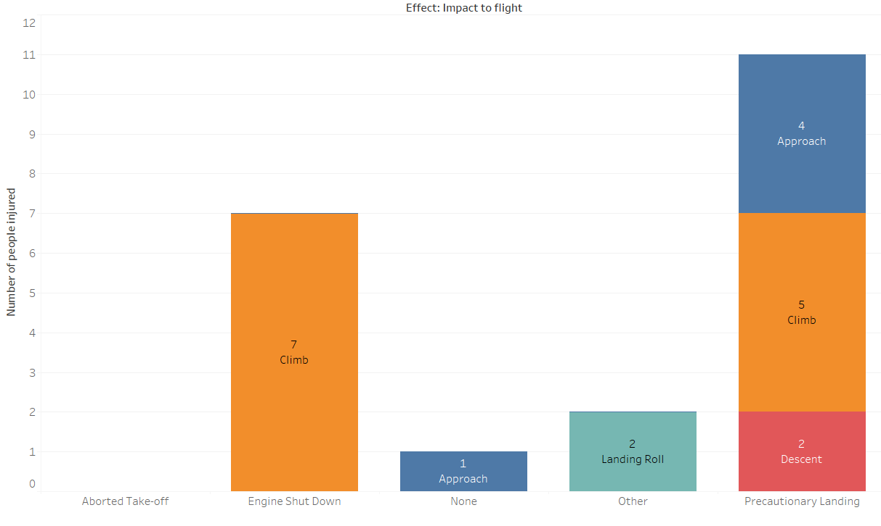
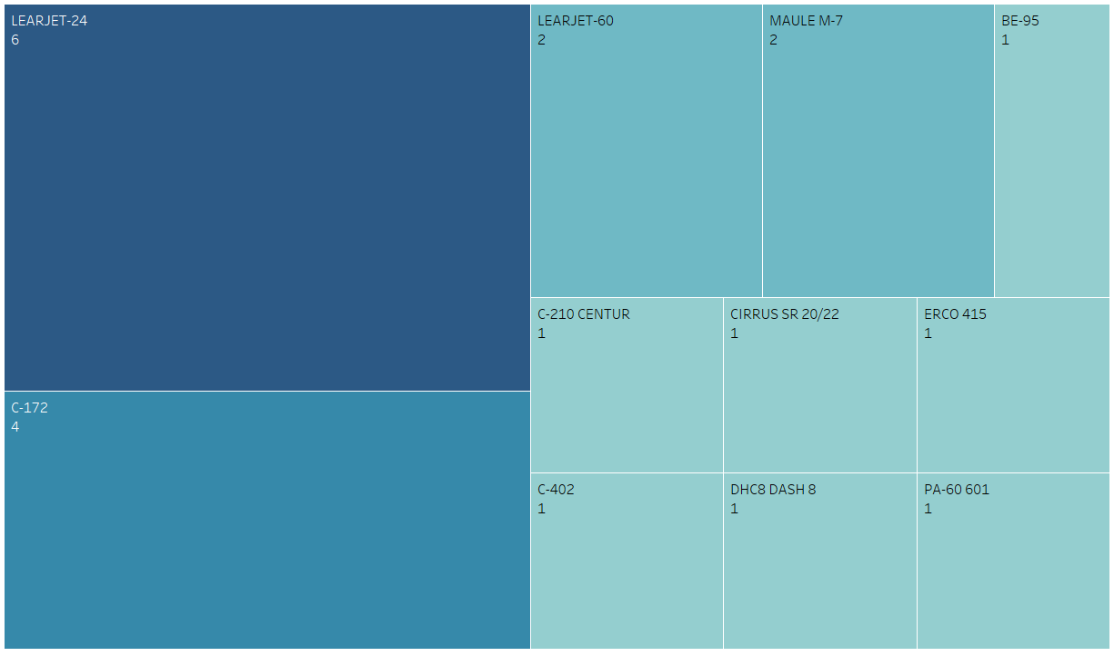
Injury Prevention Analysis
1. Types of incidents that lead to injuries.
2. Correlation between specific aircraft characteristics
Interpretation:
During Climb phase more no of people got injured.
Interpretation:
LEARJET-24 has the highest correlation

Slide 10
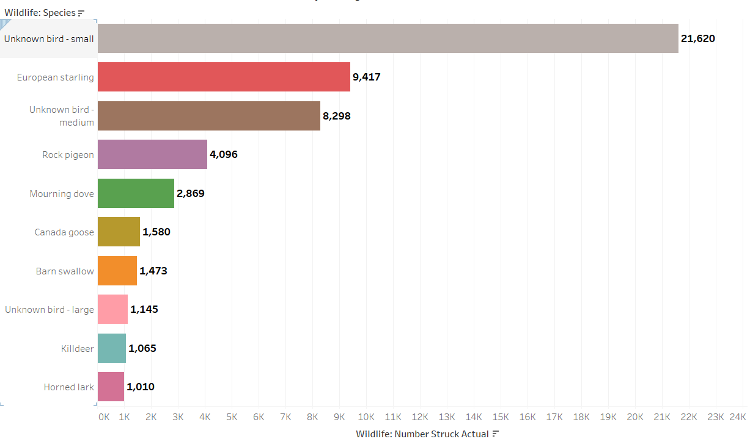
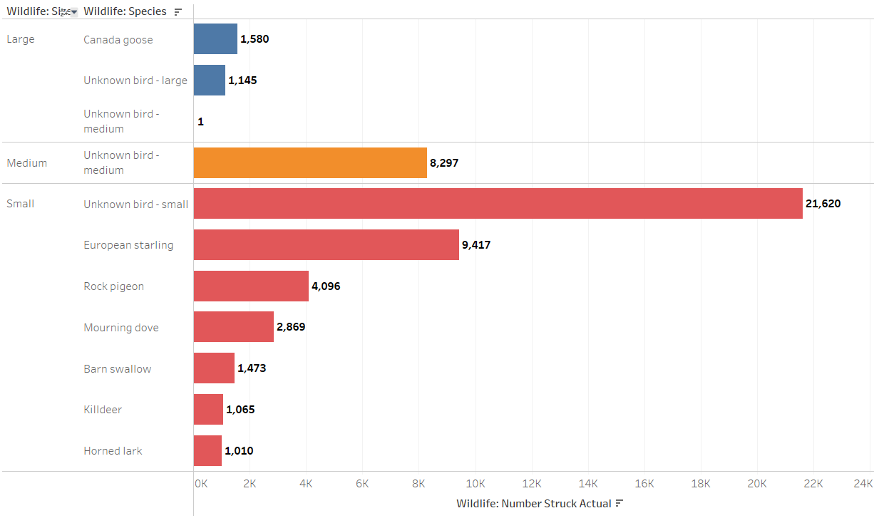
Wildlife Conservation Analysis
1. Most frequently Birds involved in strikes
2. Most frequently Birds involved in strikes based on Size
Interpretation:
Unknown Bird Small has been the most frequently involved bird in strikes
Interpretation:
In small, Unknown Bird Small has created more damage

Slide 11
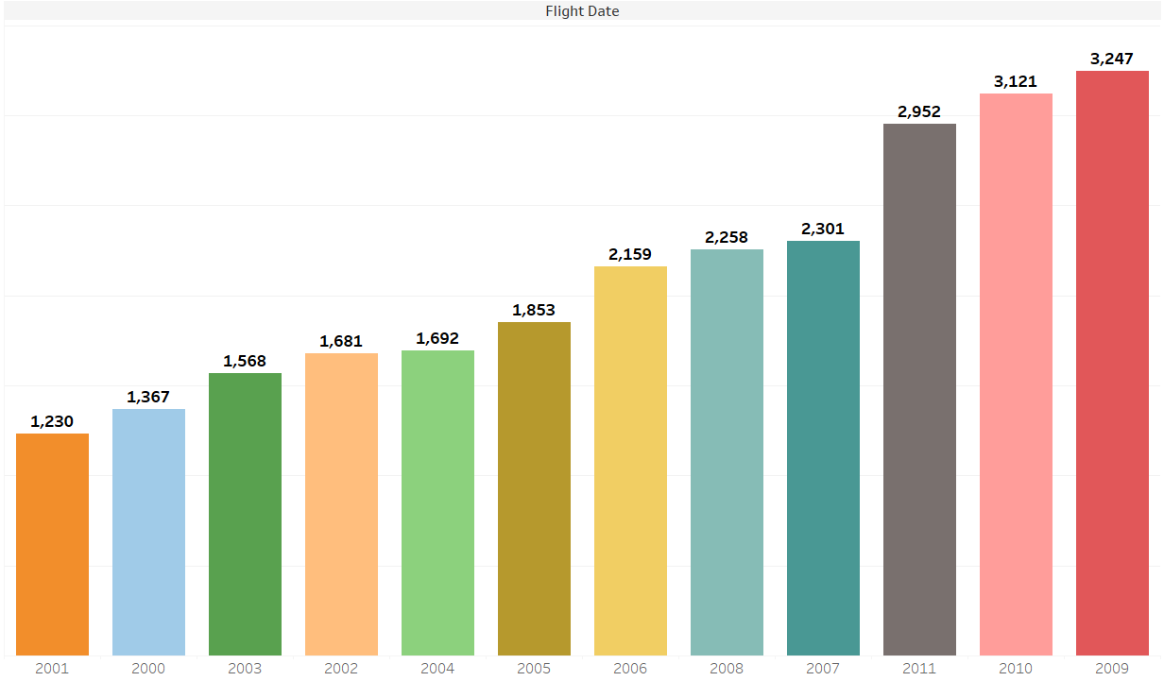
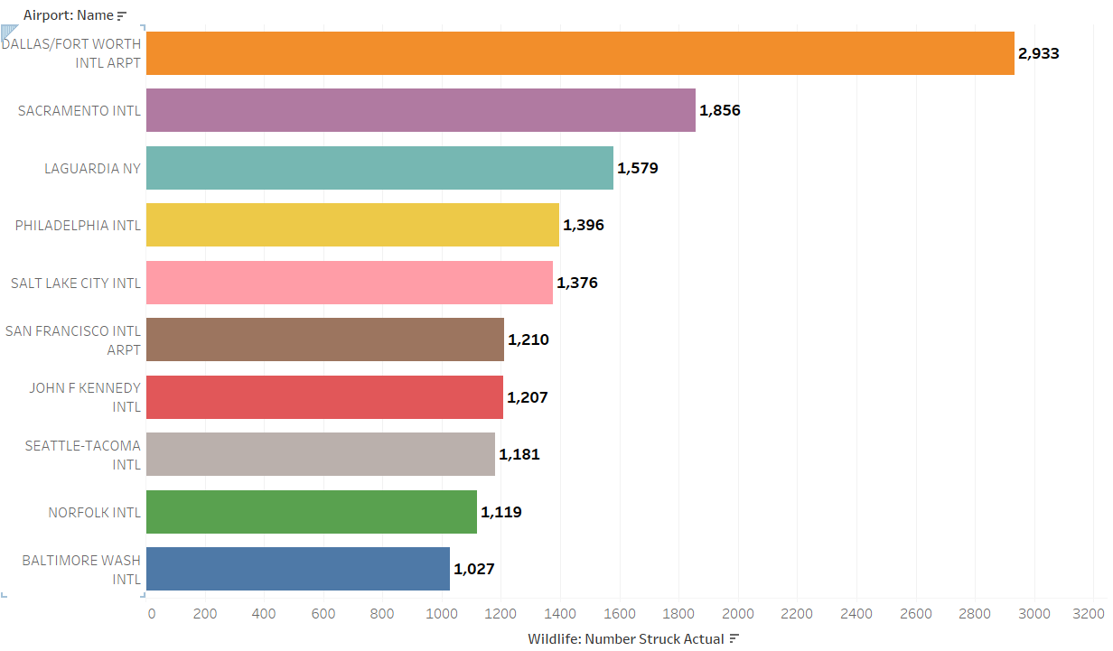
Operational Efficiency Analysis
1. Bird strikes affect flight schedules and operations
2. Specific locations Risk of bird strikes is higher
Interpretation:
In 2009, the highest Bird strikes affected flight schedules and operations more number of birds.
Interpretation:
Dallas/Fort Worth Intl Airport has the highest Risk

Slide 12
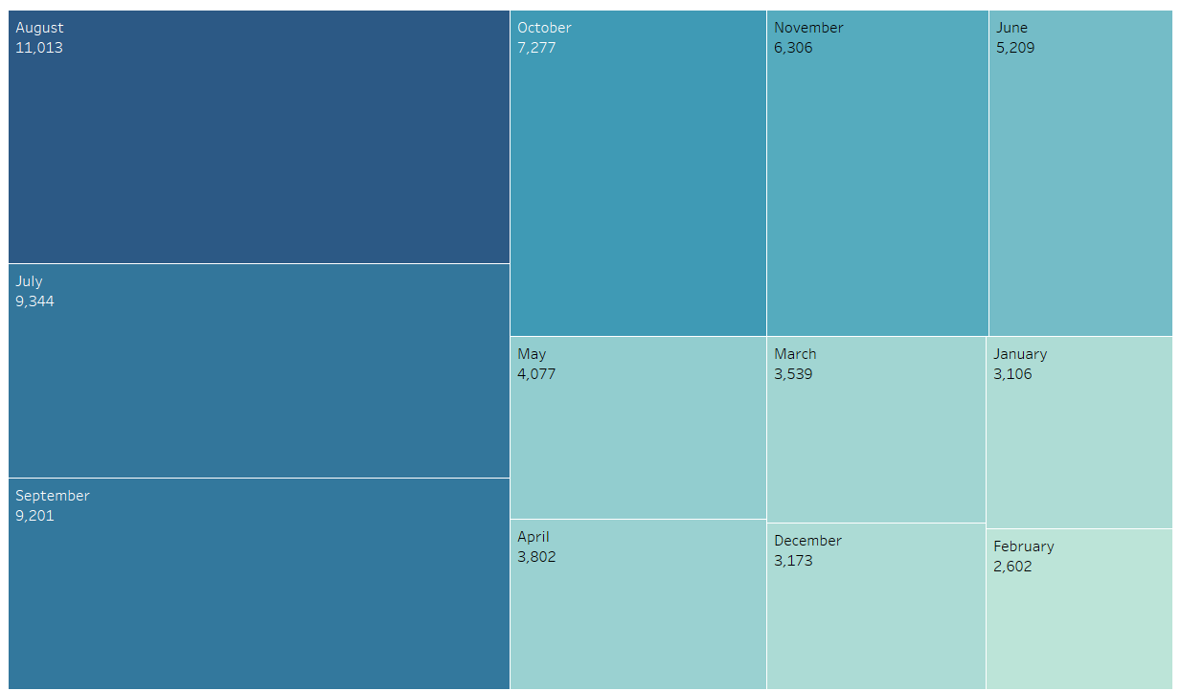
Operational Efficiency Analysis
3. Optimize flight schedules to minimize the impact of bird strikes on operations
Interpretation:
Minimize the impact of bird strikes on operations in February

Slide 13
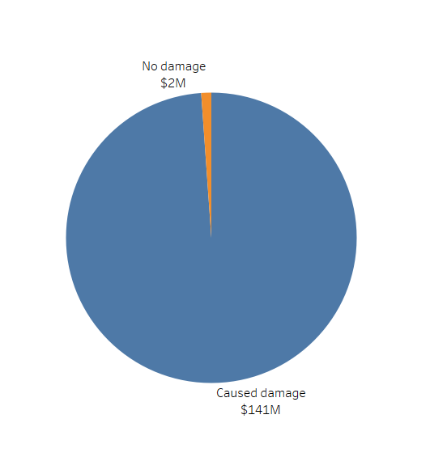
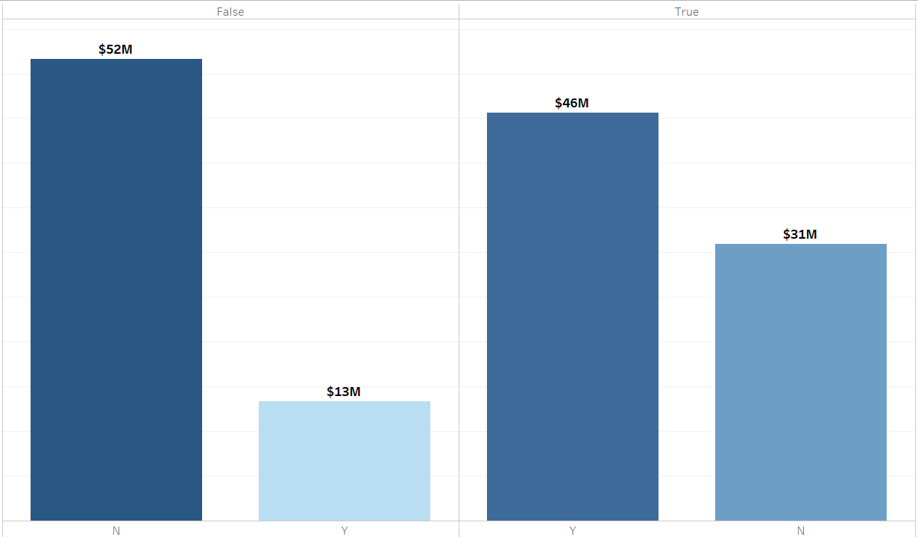
Cost Reduction Analysis
1. Total cost associated with wildlife strikes
2. The economic impact of bird strikes
Interpretation:
Total Cost Caused Damage $141M
Interpretation:
Economic impact of bird strikes $46M

Slide 14
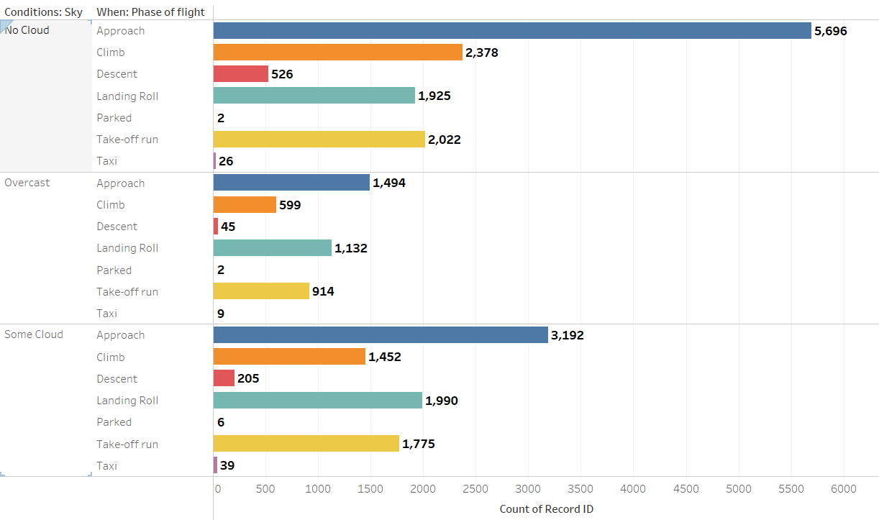
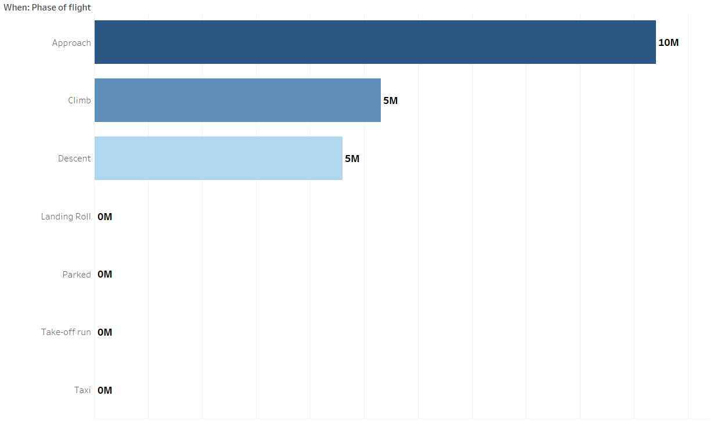
Risk Management Analysis
1. Identifies high-risk conditions, altitudes, and flight phases for wildlife strikes
2. Predictive models should be developed to identify and prevent potential wildlife strike incidents
Interpretation:
France has the Highest Sales Across Other territories.
Interpretation:
Approach has 10M

Slide 15
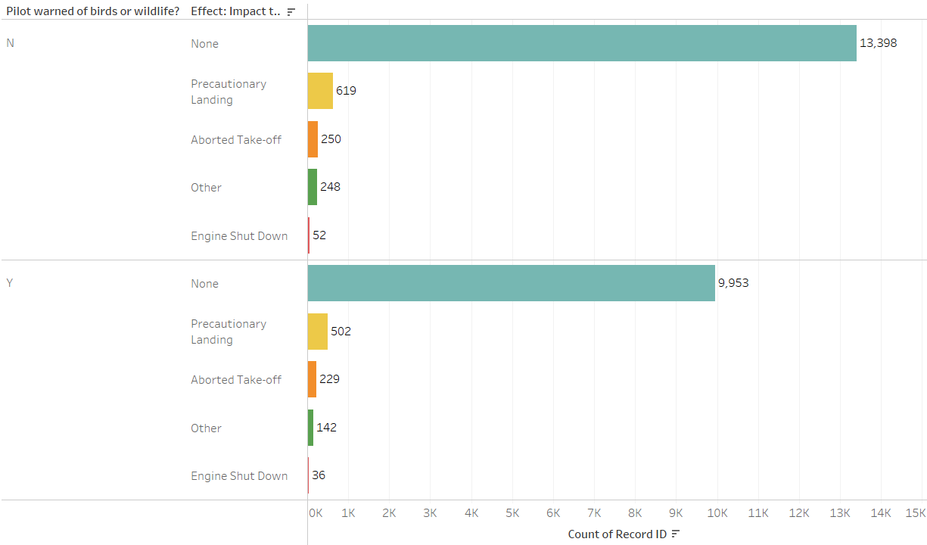
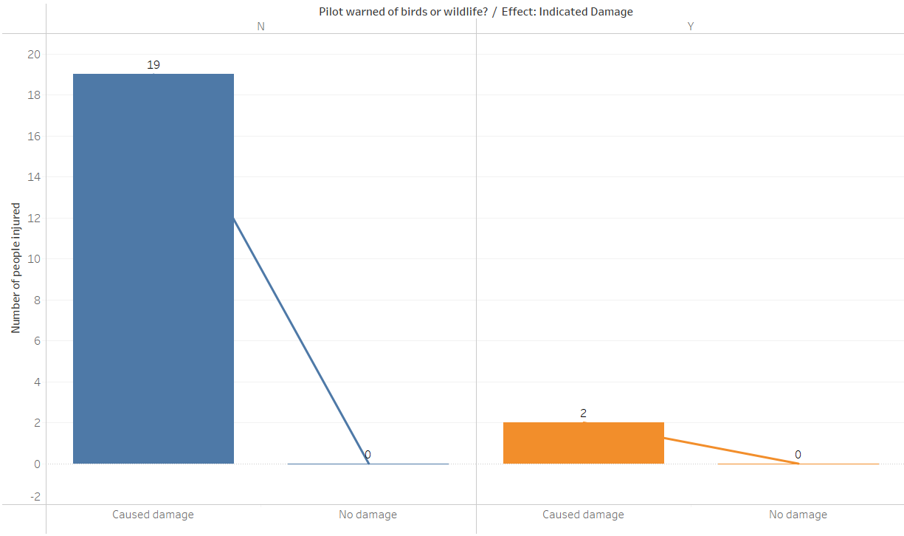
Communication and Training Analysis
1. Effective are current pilot training programs in raising awareness about wildlife strikes
2. Communication strategies can enhance pilot awareness and response to wildlife strike risks
Interpretation:
Training is not appropriate, as the damage is more
Interpretation:
Communication with pilots helps in decrease of strikes.

Slide 16
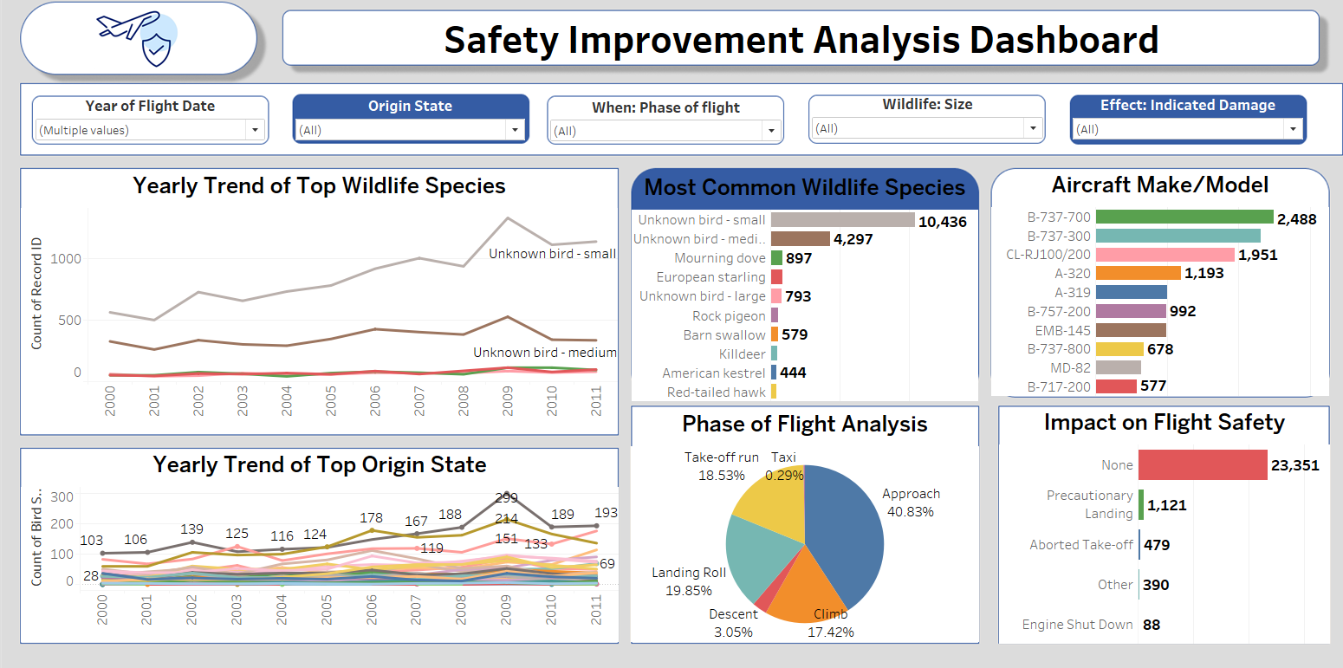

Slide 17
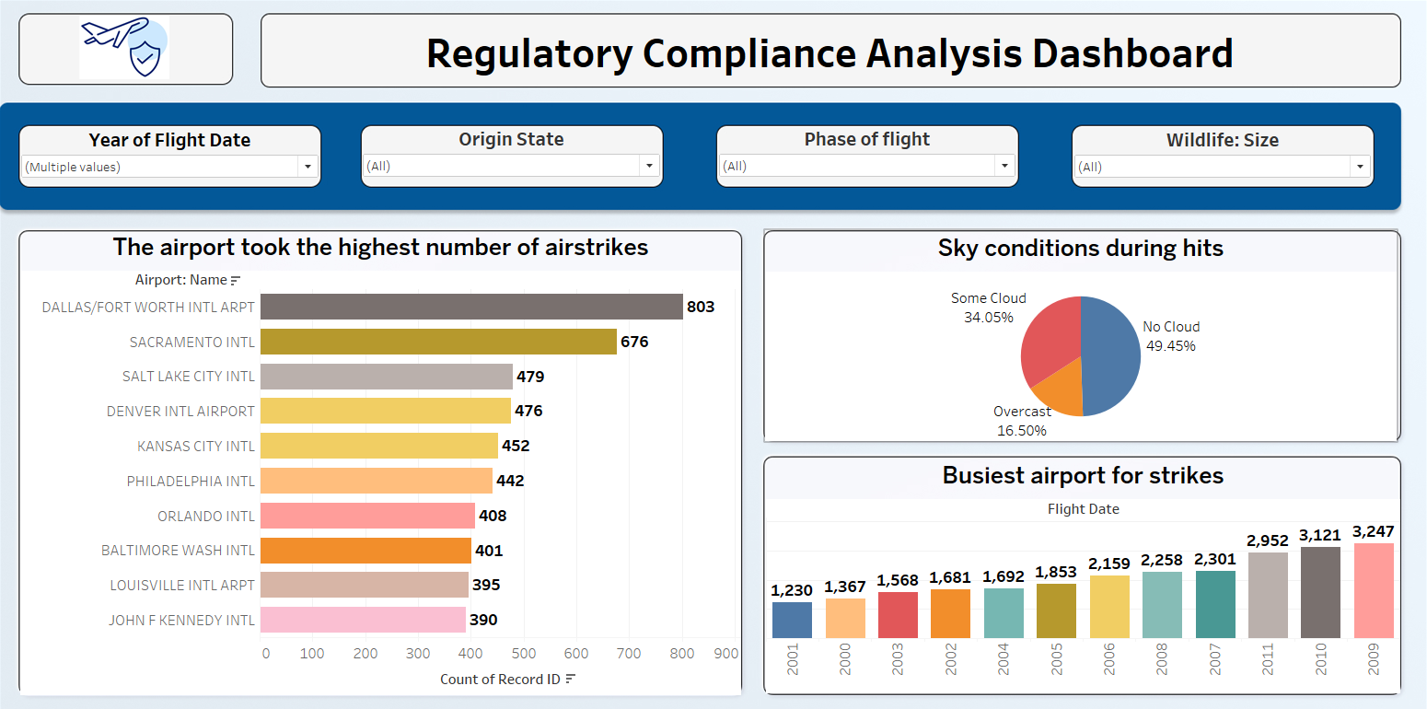

Slide 18
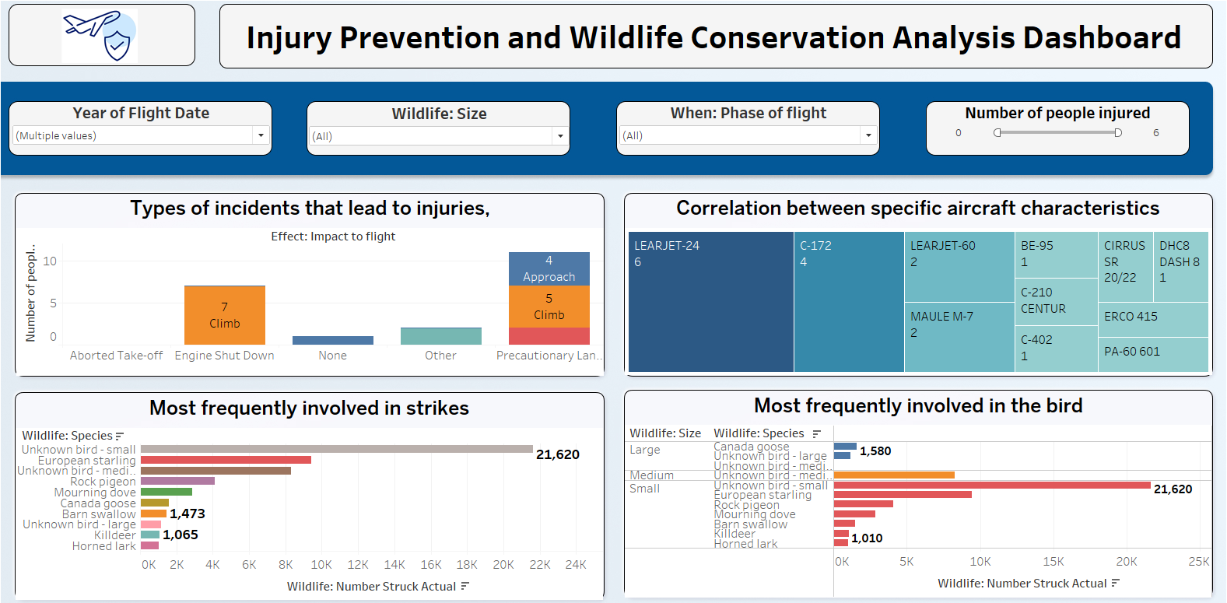

Slide 19
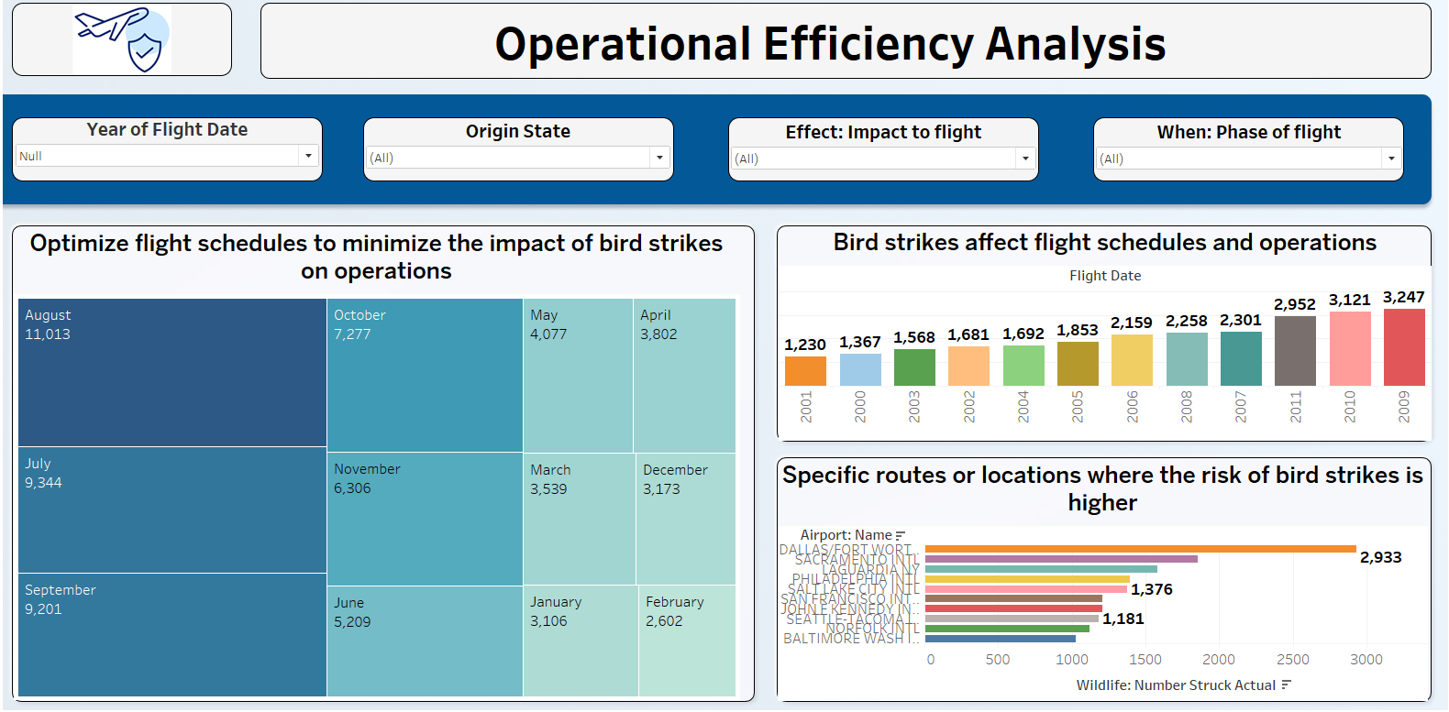

Slide 20
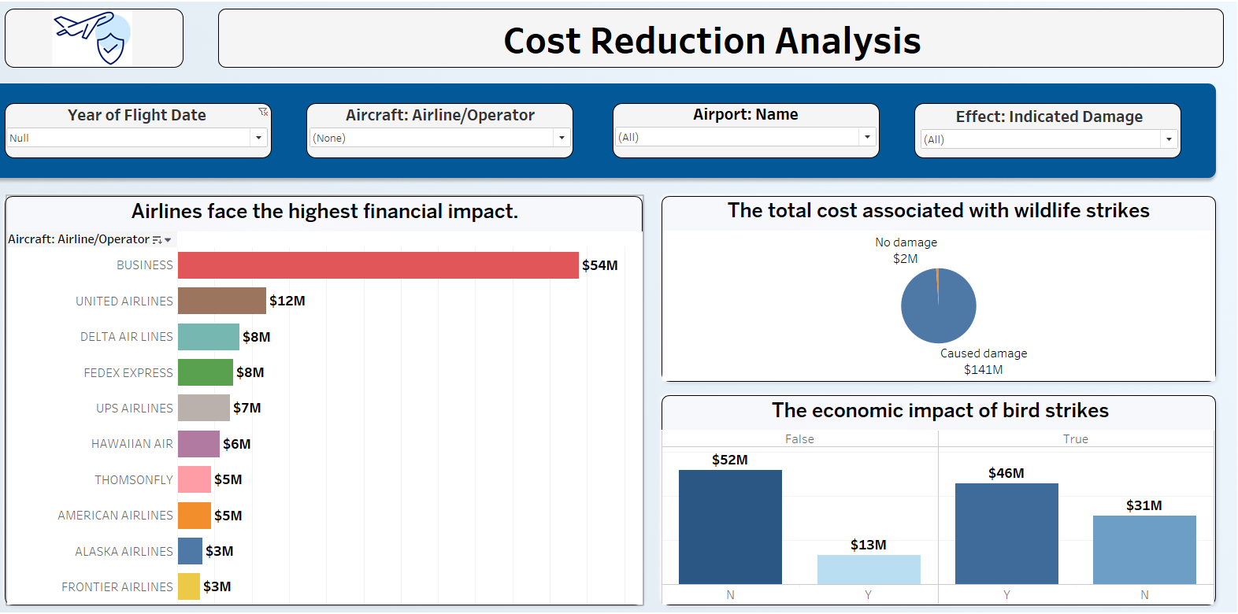

Slide 21
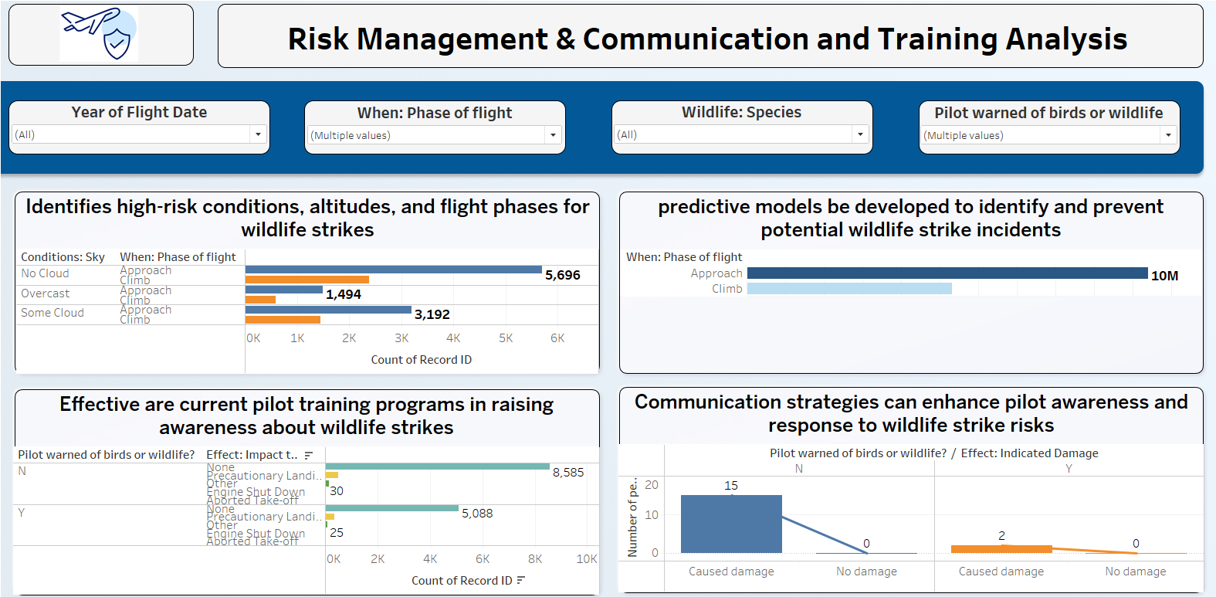

Slide 22
SUMMARY
Study bird strike patterns based on location, altitude, time, and season.
Locate high-risk airports and zones using data and mapping tools.
Review and assess the effectiveness of current mitigation strategies.
Examine environmental factors like attracting birds.
Create predictive models to estimate bird strike risk levels.
Evaluate the operational, safety, and financial impact of bird strikes.
Suggest better training and communication methods for aviation personnel.
Recommend policy updates and technology adoption for long-term risk reduction.

Slide 23
Conclusion
Unknown Small Birds are the most frequently involved species in bird strikes.
The approach phase is the most common flight phase for bird strikes.
B-737-700 is the aircraft model most affected by bird collisions.
The year 2009 recorded the highest number of bird strike incidents.
Clear sky conditions (49.45%) were present in nearly half of the strikes.
Dallas/Fort Worth International Airport reported the highest number and risk of bird strikes.
The climb phase of flight resulted in the most injuries due to bird strikes.
LEARJET-24 showed the highest statistical correlation with bird strike data.

Slide 24
Conclusion
Bird strikes caused a total damage cost of $141 million.
The economic impact of bird strikes was estimated at $46 million.
Flight schedules and operations were most affected by bird strikes in 2009.
February was identified as a critical month requiring more focus on bird strike mitigation.
Current training programs are insufficient, as damage and injury rates remain high.
Improved communication with pilots helps reduce the number of strike incidents.
Environmental factors, such as proximity to landfills and wetlands, contribute to higher strike risk.
Stronger regulatory compliance and enhanced wildlife management are essential to reduce long-term risks.

Slide 25
THANK YOU

